Slide 1

The Feedback Loop
Siddharth Singh Rana, Rakshit Rautela

Slide 2
Introduction
New age needs of content creation for business and individuals.
To make your brand/content visible.
Building customers/viewers worldwide.
Creating a similar minded audience.
Creating a brand identity.
Increase Reach.

Slide 3
What does Feedback Loop do:
01
02
03
Problem statement.
Our solution.
Solution Structure.

Slide 4
01
The Problem Statement

Slide 5
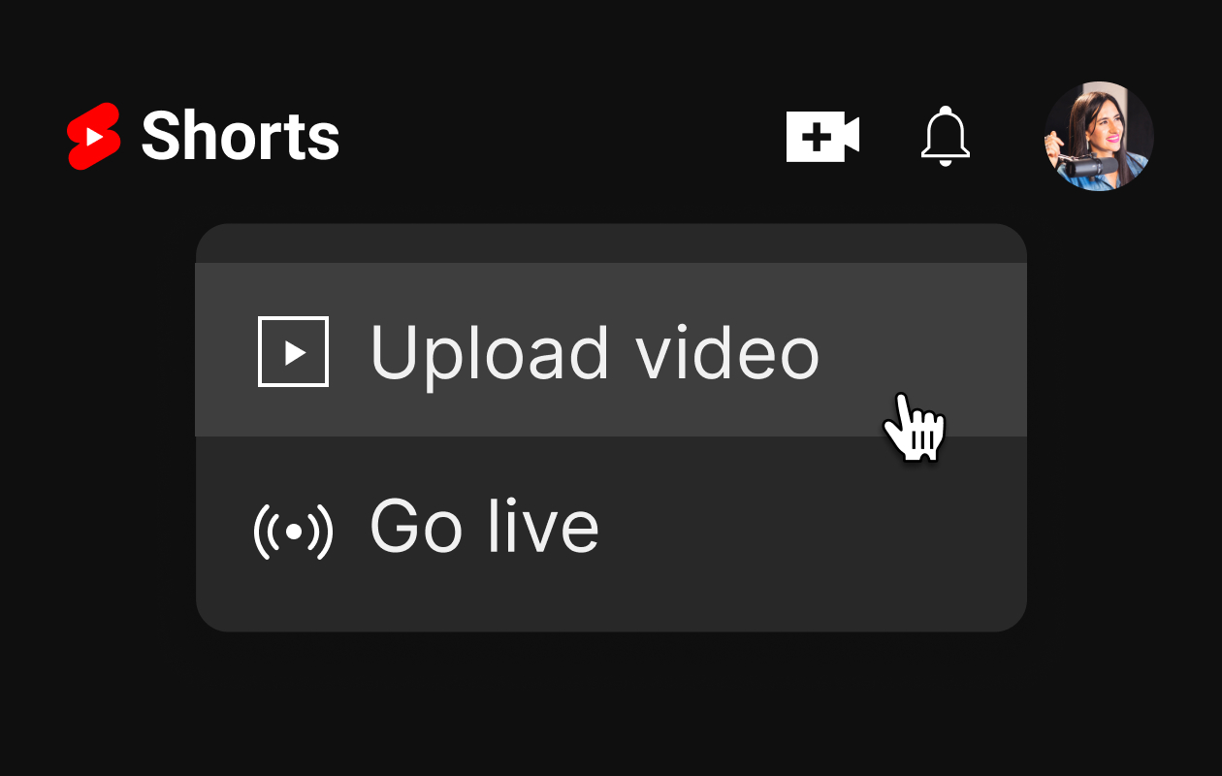
Uncertainty

Slide 6
Will the video reach the right audience.
Will it perform good even if it reaches.
Will it present the idea accordingly.
Will customers attract to my idea.
Will the video even reach anywhere.
What are other big brands or creators doing that are successful in this field.

Slide 7
02
Our Solution

Slide 8
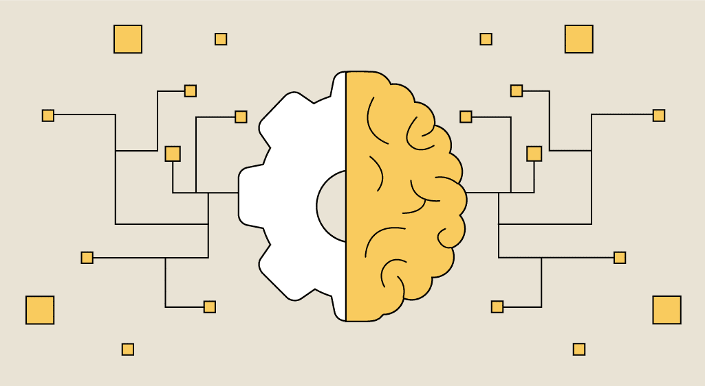
Providing Feedback On Videos
1.

Slide 9

2.

Slide 10
03
Solution Structure

Slide 11
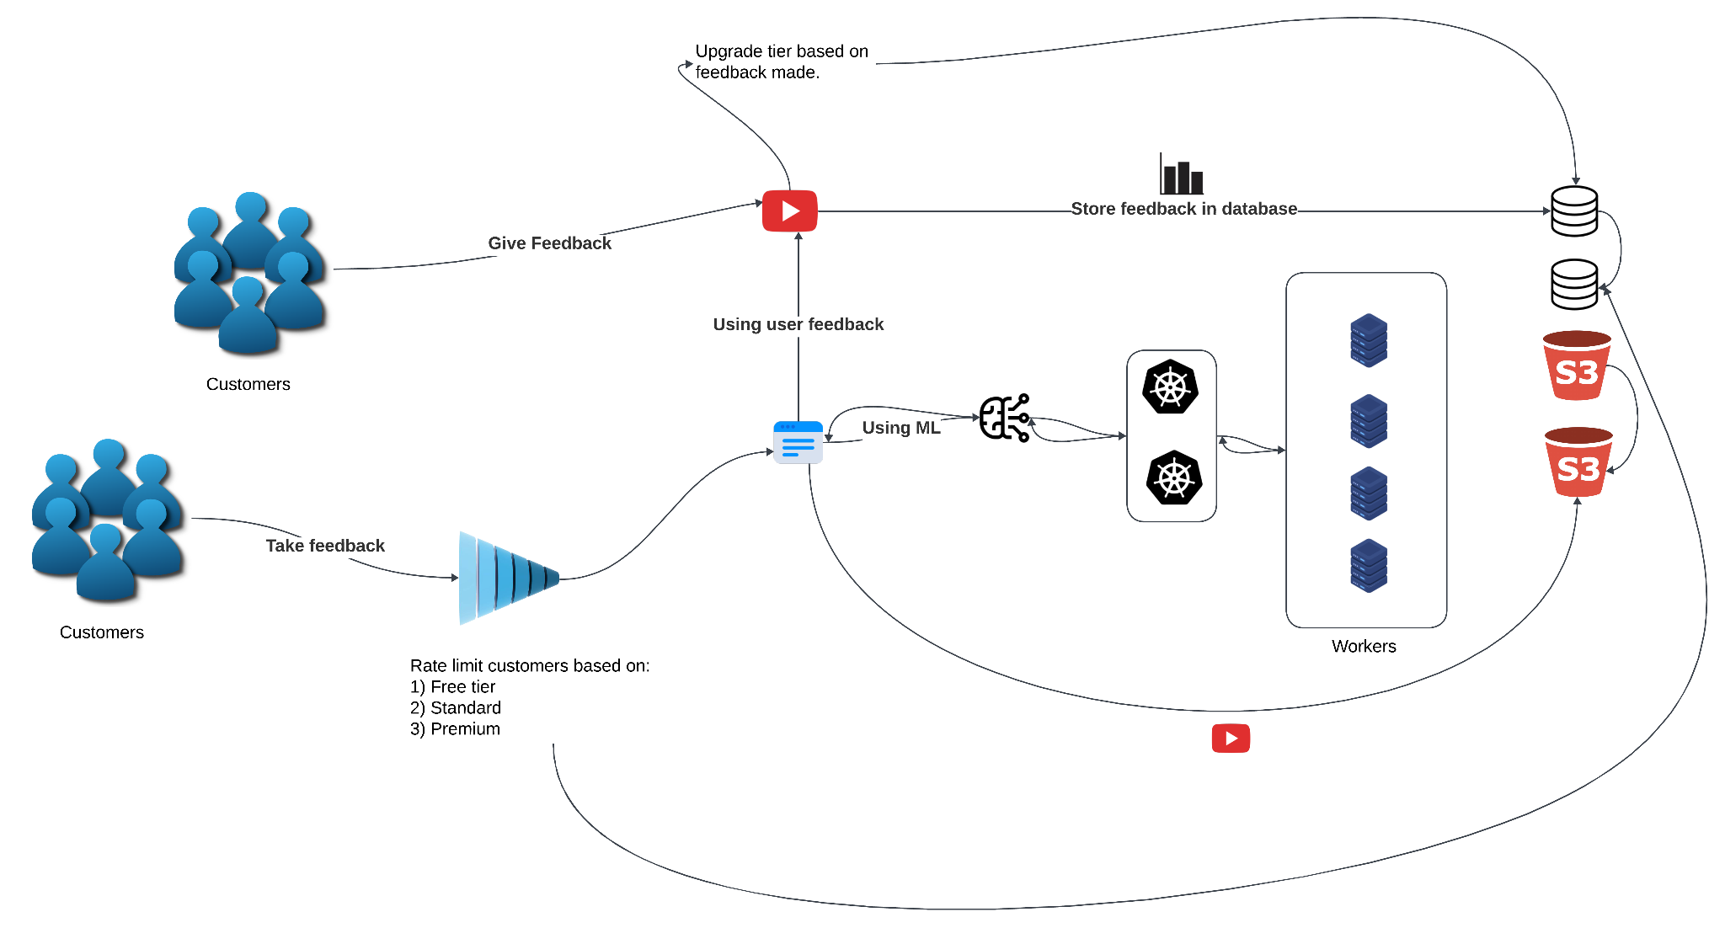

Slide 12
What we have implemented so far :
User subscription model. 100%
Machine learning models. 70%
Feedback Logic. 80%
Storing feedback. 100%
Feedback visuals. 50%

Slide 13
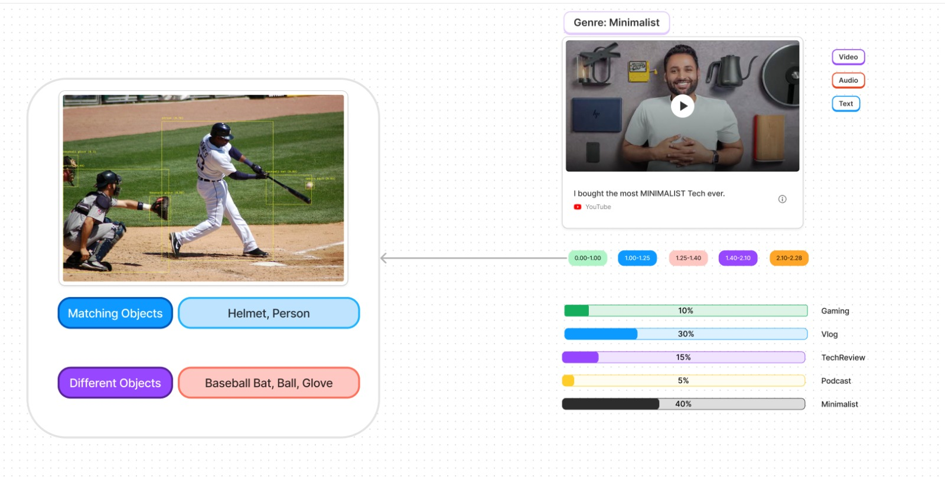

Slide 14
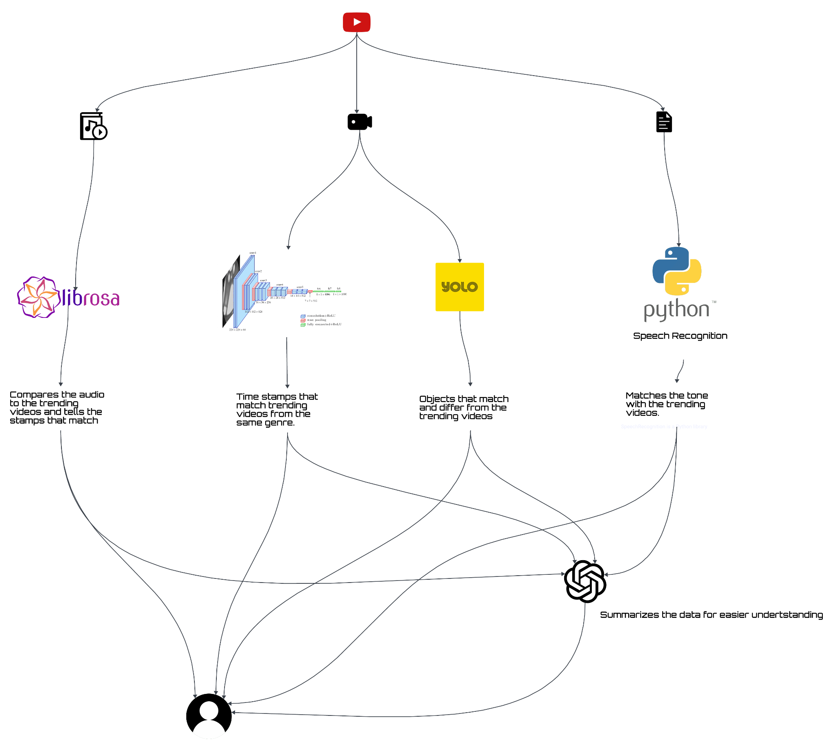

Slide 15
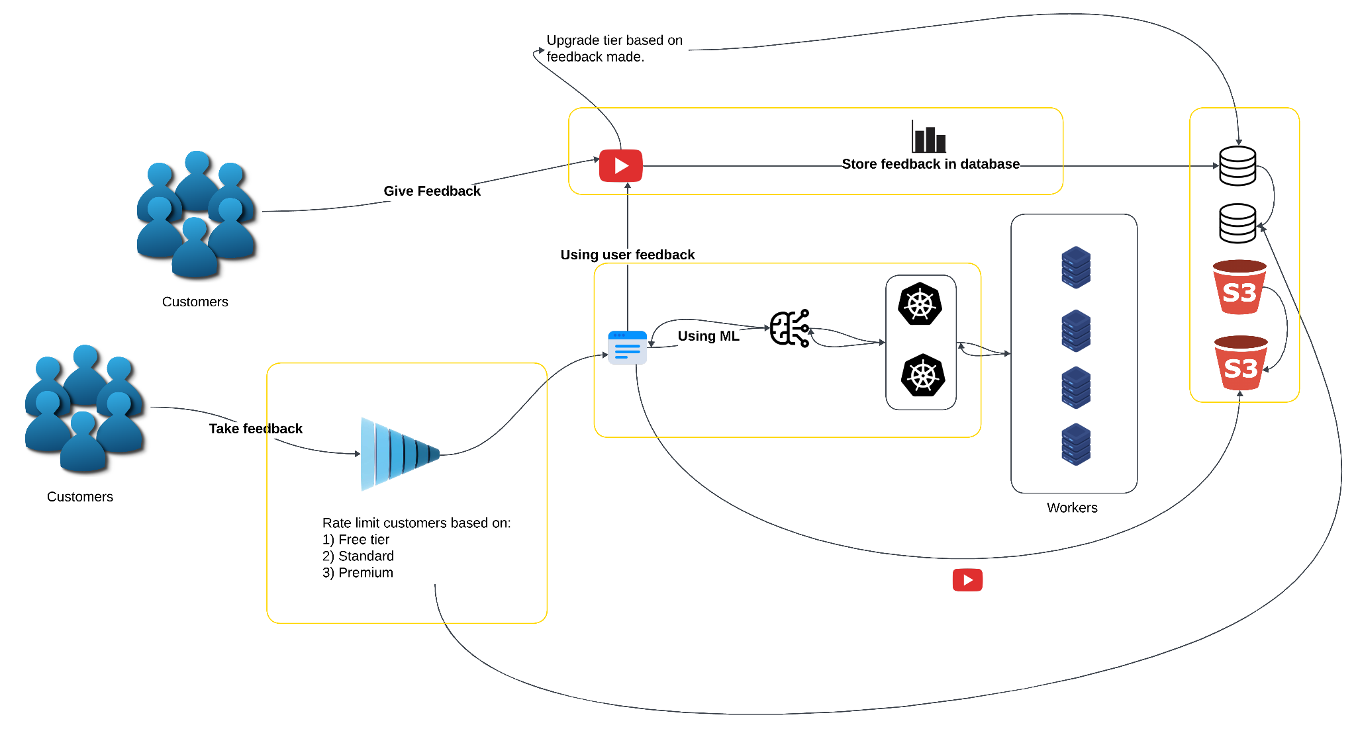

Slide 16
What kind of support we are looking for :
Resources to implement the workers.
Any type of feedback or additional inputs.
What kind of additional support we are looking for:
Resources to train our models.

Slide 17
Goals:
Get Customers: Attract and keep customers.
Improve Products: Keep making your product or service better.
Build a Brand: Develop a strong, recognizable brand.

Slide 18
Thanks!
Do you have any questions?
siddharthsinghrana11@gmail.com
+91 8445 0674 01
https://siddharth-dev-portfolio.netlify.app/

